Slide 1


Raihan Insan Habibi
Wednesday, January 5, 2022 - Friday, January 14,2022

Slide 2

Outline
Executive Summary
Introduction
Methodology
Results
Conclusion
Appendix

Slide 3
Executive Summary
In this presentation, our goal is to find the best location for the space X to launch and land. We will also find other features that affects the launch and land outcome.
We will use the Space X API to extract the information
We will use SQL to filter out the data and draw out conclusions
We will use matplotlib to plot beautiful visualizations such as bar charts and scatter plots, we will use these modules find out the pattern of the investigation.
We will create a machine learning module that predicts the data
We also need to find how accurate the module is

Slide 4
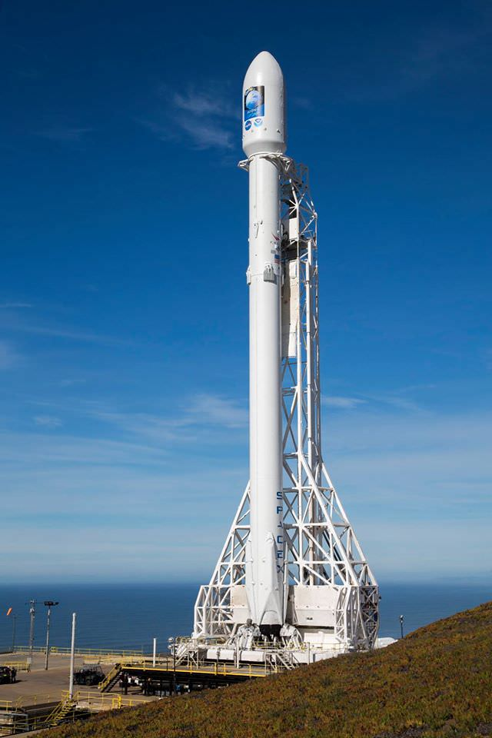
Introduction
In December 2015, Elon Musk made the first-ever orbital rocket called the ‘Falcon 9 heavy’. It was the first ever rocket that made a vertical landing back to Earth and it was a successful return . This Mission started back in 2010, where after several failed attempts, the engineering was a masterpiece. The failed attempts were caused by environmental features and the launch and landing sites, the location was not too perfect for the rocket. As a result, the rocket was destroyed for every attempt, losing a lot of money and resources in the budget. As a Data Scientist, I will show you in this presentation how I was able to find a perfect location for the rocket to land and launch using Python, SQL and the Space X API to analyze the data and give the best result.
This Photo by Unknown Author is licensed under CC BY

Slide 5


Slide 6
Methodology
Executive Summary
Data collection methodology:
Using the space x API, extract the information in the form of a JSON file.
Convert the JSON file into a dataset (for cleaning and filtering).
Perform data wrangling
Beautiful Soup Module to extract the information we need from the HTML .
First we used the title dot text method to extract the title of the website.
Then using a ‘for loop’ to automatically append the information to our new filtered dataset.
Perform exploratory data analysis (EDA) using visualization and SQL
Perform interactive visual analytics using Folium and Plotly Dash
Perform predictive analysis using classification models:
Using the dataset, we need to train and test the dataset using the train_test_split method
We then create a module to predict the future outcome
Finally we state how accurate the module is.

Slide 7
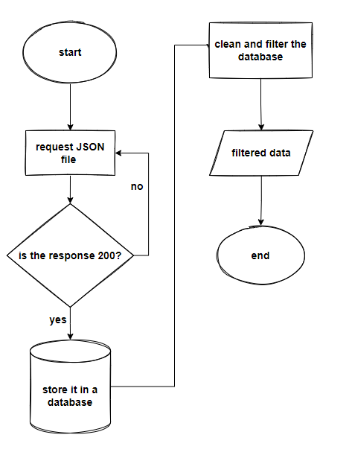
Data Collection
The URL is first input into a string.
we take the response by requesting it using the Request Module.
If the response is a success we can collect the data in the form of a JSON file then filter out the data we need.
We can then form this data into a database.

Slide 8
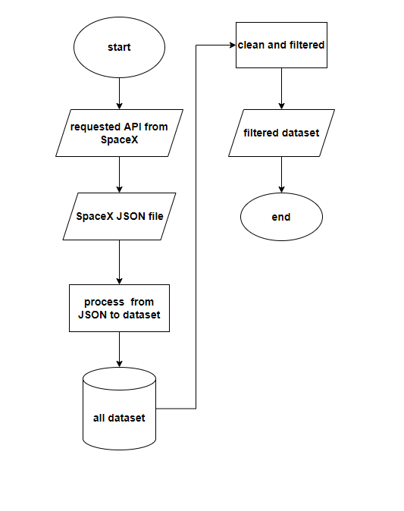
Data Collection – SpaceX API
reference:
https://github.com/RaihanTeachesCodes/IBM_course_10-/blob/master/data%20collection.ipynb
When we requested the SpaceX API using the request module we have to get a status code of 200, to have a successful request and response.
We then normalize the JSON file to turn it in to a dataset.

Slide 9
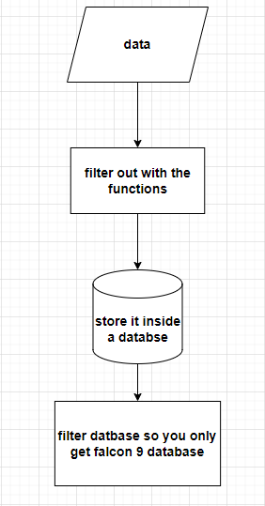
Data Collection - Scraping
Reference:
https://github.com/RaihanTeachesCodes/IBM_course_10-/blob/master/data%20collection.ipynb
Using the data we collected we filter it out the column using the:
-getboosterversion( )
-getlaunchsite( )
-getpayloaddata( )
-getcoredata( ).
I then append the output of the functions to a list that I created.

Slide 10
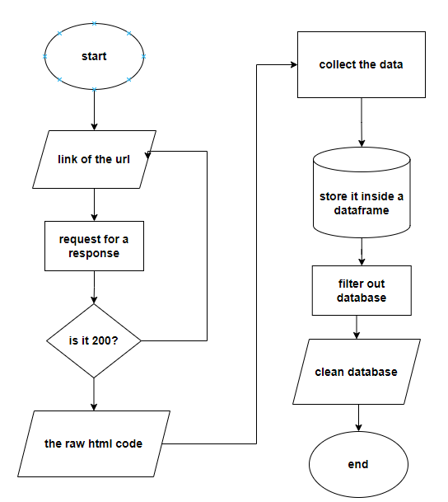
Data Wrangling
Reference:
https://github.com/RaihanTeachesCodes/IBM_course_10-final-project/blob/master/data%20wrangling.ipynb
I first extract all HTML from the Wikipedia website.
I used the title dot text method from the soup module to extract the title.
The data then was processed by using a “for loop” to automatically scrape the html.
I append these data to an empty dataset that I created.
The output is a filtered dataset.

Slide 11
EDA with Data Visualization
Reference:
https://github.com/RaihanTeachesCodes/IBM_course_10-final-project/blob/master/EDA%20with%20Data%20Visualization.ipynb
To visualize the difference of relationship between the 2 data I used a cat plot because it was a module that can make it much easier to tell the difference.
For separating the class I used a bar chart because it was easier to understand the difference of each class.
To visualize the launch success yearly trend I used a line chart because I can see the trend much easier to draw out conclusions based from the gradient .

Slide 12
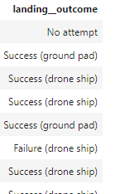
EDA with SQL
Reference:
https://github.com/RaihanTeachesCodes/IBM_course_10-final-project/blob/master/eda%20sql.ipynb
We take out the database by first connecting to my credentials.
I Filtered the dataset so at the end result I would get the Rank of the count of landing outcomes (such as Failure (drone ship) or Success (ground pad)) between the date 2010-06-04 and 2017-03-20, in descending order

Slide 13
Build an Interactive Map with Folium
Reference:
https://github.com/RaihanTeachesCodes/IBM_course_10-final-project/blob/master/interactive%20visualization%20with%20folium.ipynb
I have created circles around the mark because I want to show the accessible landing site in a specific radius.
The markers are used to point out the location of the landing site. And the line is used to represent the distance between a launch site to its proximities.
These object creates a beautiful visualization to the folium map with clear understanding about the data.

Slide 14
Build a Dashboard with Plotly Dash
Reference:
https://github.com/RaihanTeachesCodes/IBM_course_10-/blob/master/spacex_dash_app.py
I have added the pie charts because its easier to classify each variable values in different class.
the Dropdown options is there to give different data about the launching site.
the slider changes the results of the payload mass, giving different ranges
And lastly the scatter chart shows the relationship between two variables.

Slide 15
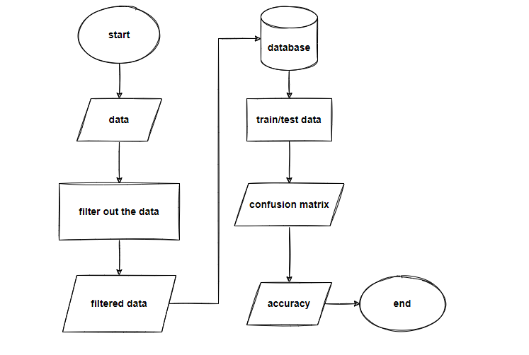
Predictive Analysis (Classification)
Reference:
https://github.com/RaihanTeachesCodes/IBM_course_10-/blob/master/Machine%20Learning%20Prediction.ipynb
After I took the database, I transformed the dataset so it is trainable.
Then I train and tested the data using the train_test_split method to create a module.
I then output all types of accuracy score and find out which module give out the highest accuracy.
I made a confusion matrix to evaluate the module

Slide 16
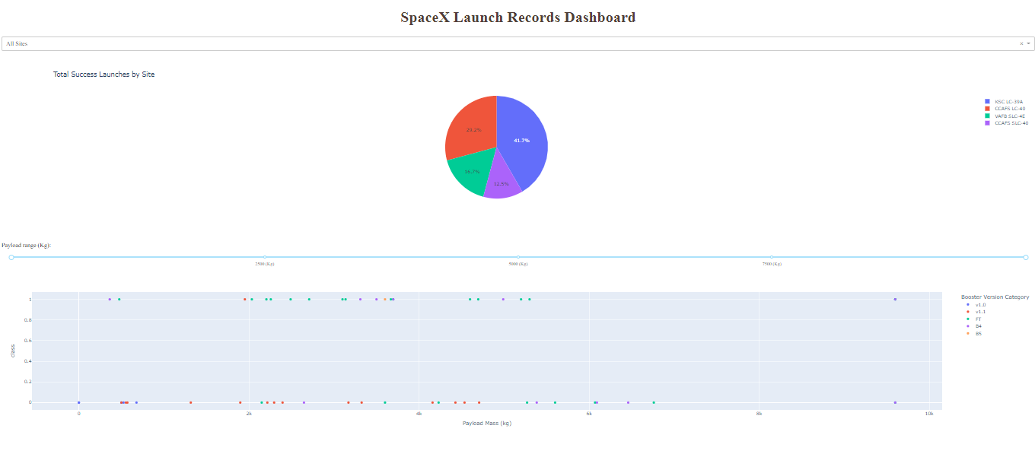
Results
Exploratory data analysis results
Predictive analysis results

Slide 17
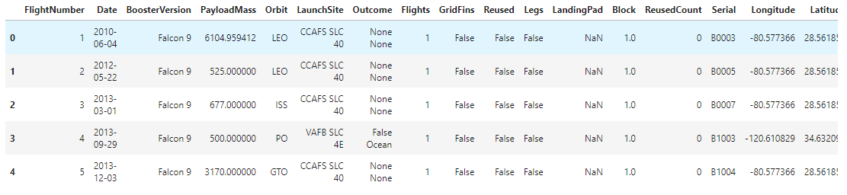
Results
Exploratory data analysis results
Predictive analysis results

Slide 18
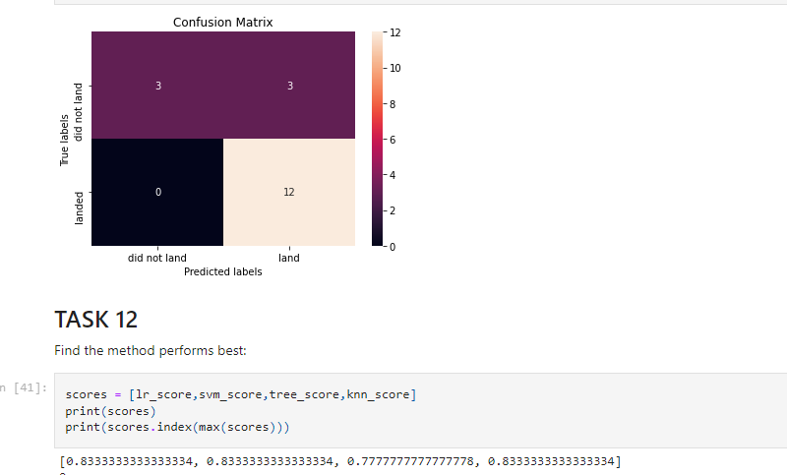
Results
Exploratory data analysis results
Predictive analysis results

Slide 19


Slide 20
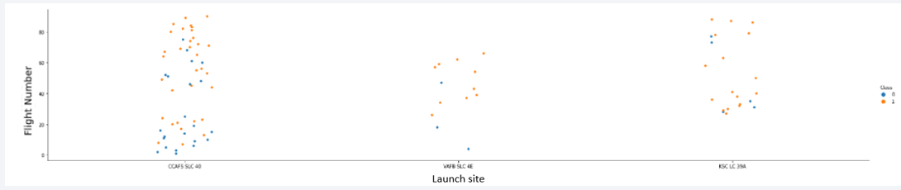
Flight Number vs. Launch Site
As you can see from this scatter plot, most launch site is in ‘CCAFS LC-40’ ,
The least number is in launch site ‘VAFB SLC 4E’.

Slide 21
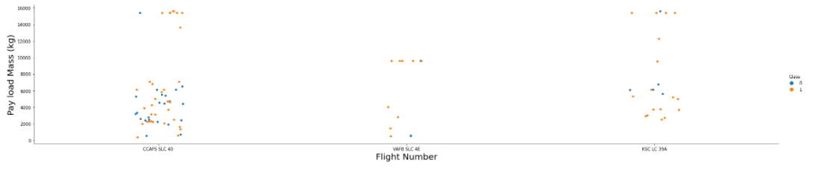
Payload vs. Launch Site
The highest pay load mass will be in flight number ‘CCAFS LC-40’.
The smallest pay load mass will be between CCAFS LC-40 or VAFB SLC 4E

Slide 22
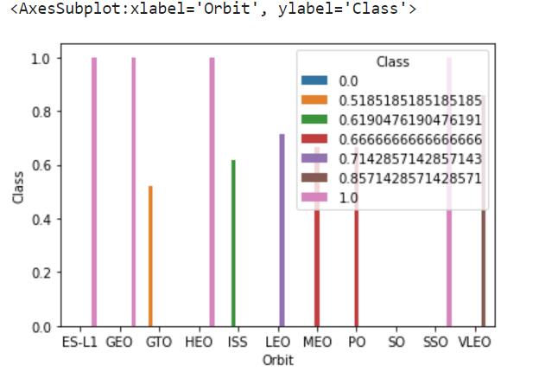
Success Rate vs. Orbit Type
The bar chart shows the relationship of the success rate and orbit type.
It shows that the class with the pink color give a 100% success rate.
While the class with the blue color gives 0% success rate.

Slide 23
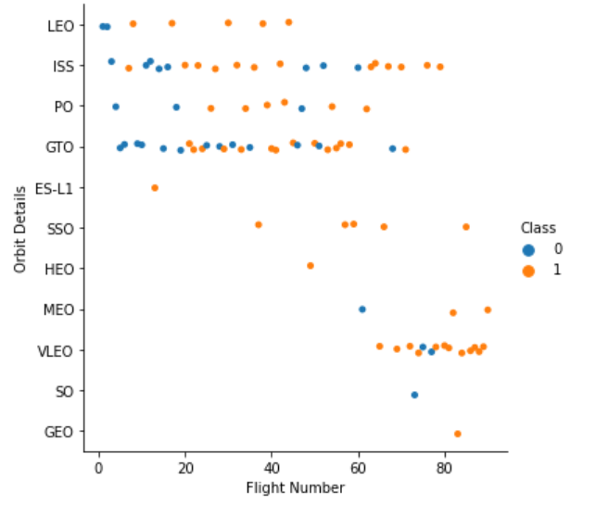
Flight Number vs. Orbit Type
The graph shows the relationship between flight number and orbit details.
This shows that GEO has small relationship with flight number.
While GTO has the highest relationship with flight number.

Slide 24
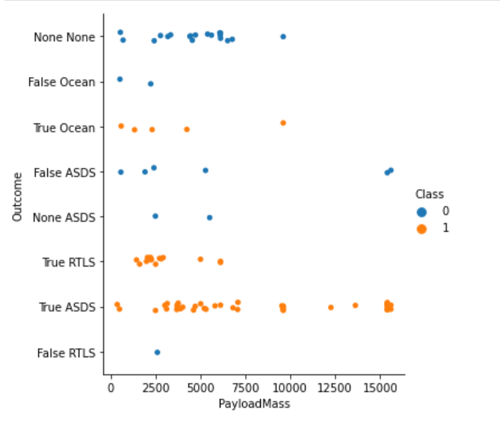
Payload vs. Orbit Type
The scatter plot shows the relationship between Pay load mass and orbit outcome.
The true ASDS give the highest payloadmass

Slide 25
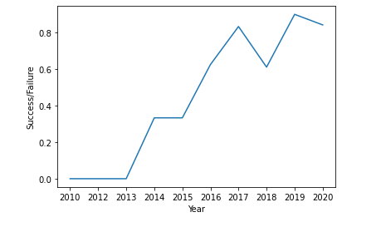
Launch Success Yearly Trend
The line graph shows the success rate / year of every launch .
The gradient expresses the trend increases.
There is a fluctuation between 2017 – 2019.

Slide 26
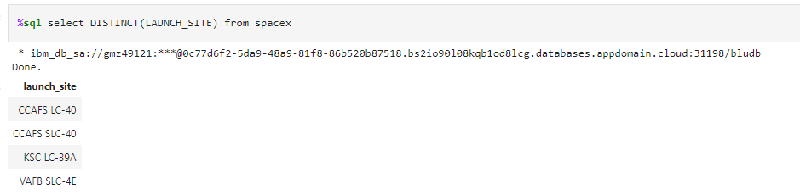
All Launch Site Names
The result gives out 3 unique names of the launch names
I used the distinct function to give out the unique values.

Slide 27
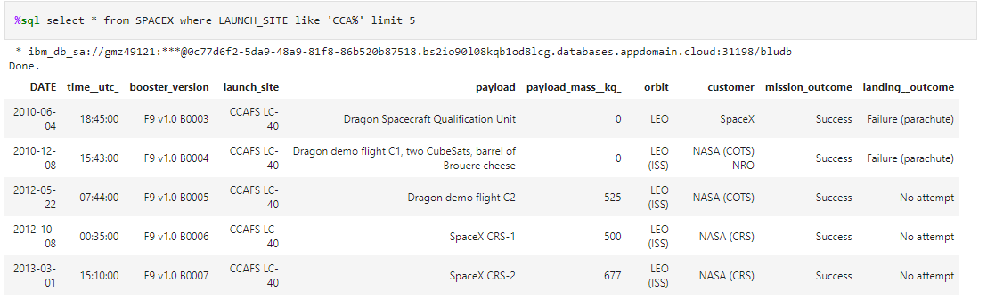
Launch Site Names Begin with 'CCA'
These launch names are 5 records where launch sites begin with `CCA`
There are actually more data but I only give only limit 5 for display purposes.

Slide 28
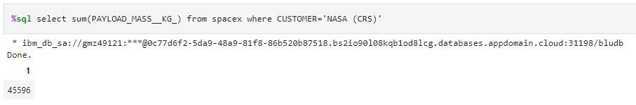
Total Payload Mass
Using the sum function I was able to find out the sum of the payloadmass.
I only took the data where the customer column is ‘NASA (CRS)’

Slide 29
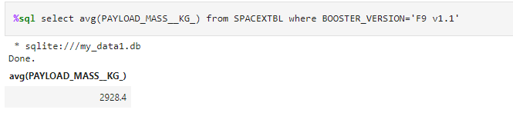
Average Payload Mass by F9 v1.1
The output is the average payload mass carried by booster version F9 v1.1
Using the avg function I was able to find out the total average of the payloadmass.

Slide 30
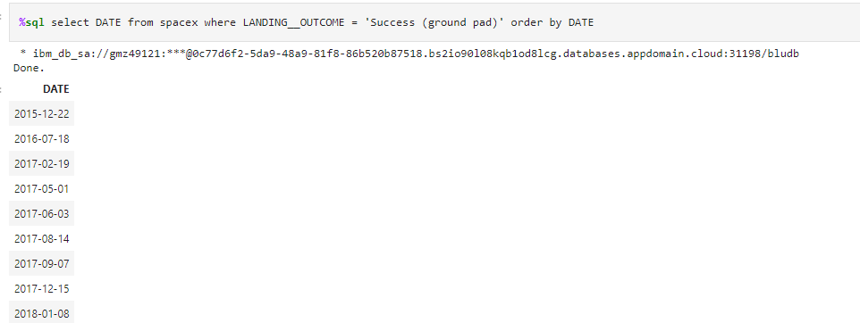
First Successful Ground Landing Date
I filtered the column where the landing column is a success.
I output a date column.
Then I ordered the date in increasing order

Slide 31
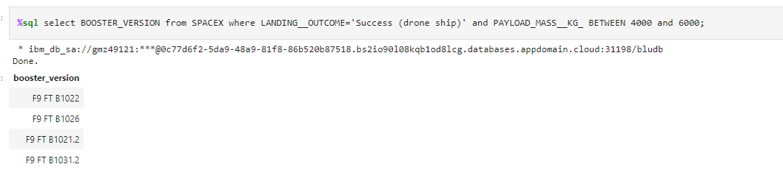
Successful Drone Ship Landing with Payload between 4000 and 6000
Using the ‘between’ method I’m able to range the values between the 2 numbers
While I output the booster version column

Slide 32
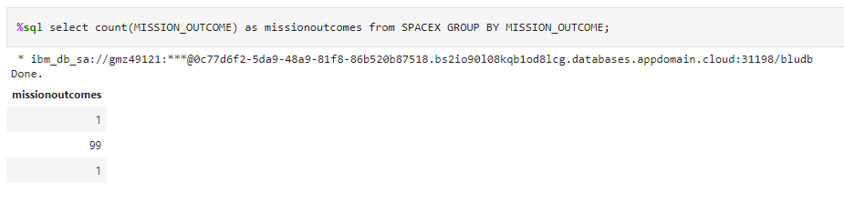
Total Number of Successful and Failure Mission Outcomes
I used a count function to find the number of mission outcomes.
I also group the variables so it gives the same data

Slide 33
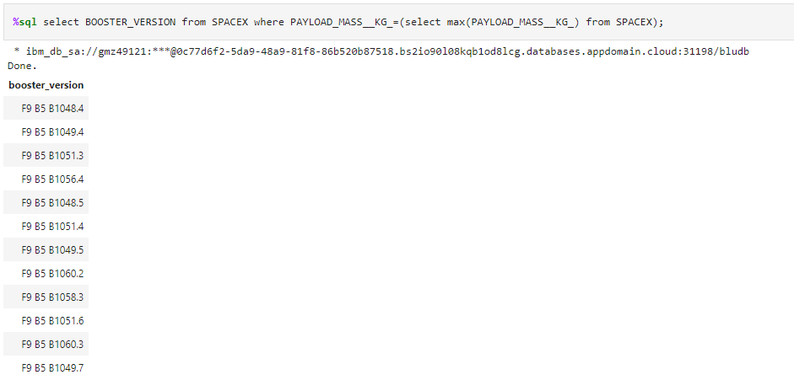
Boosters Carried Maximum Payload
Dropdown the booster version column.
The column have the maximum payloadmass

Slide 34
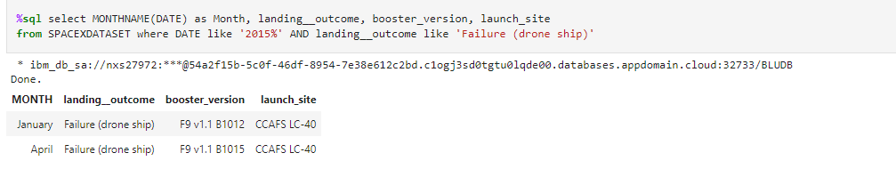
2015 Launch Records
I outcome the records on 2015. where the landing outcome is a failure.
This shows that the launch site was a failure at CCAFS LC- 40.

Slide 35
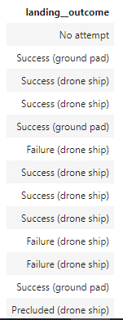
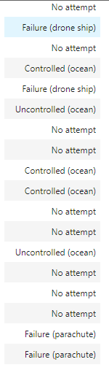
Rank Landing Outcomes Between 2010-06-04 and 2017-03-20
In this code I outcome the landing outcome of the dataset where I used a between method to take the range values in the date column.
I ordered it by date in descending order

Slide 36


Slide 37
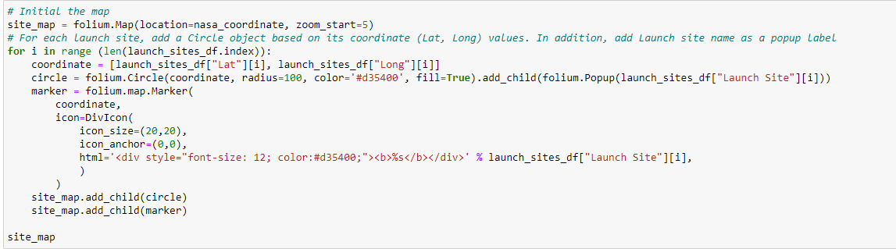
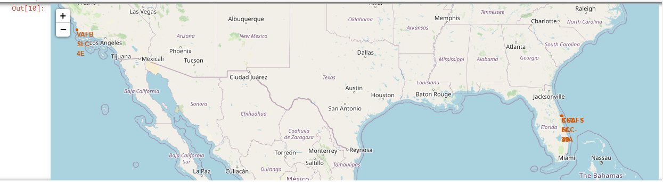
all launch sites on a map
There are 3 points in the map that represent the launching site for the space X rocket

Slide 38
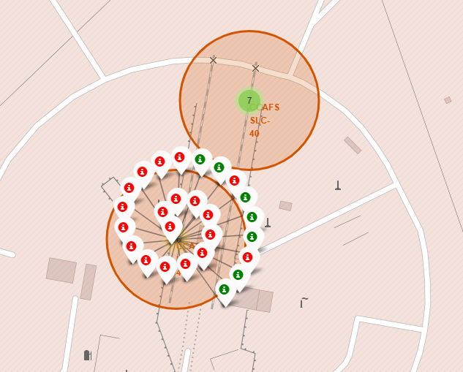
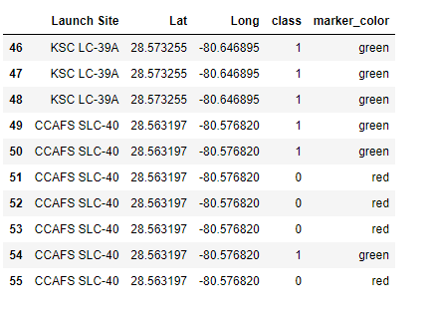
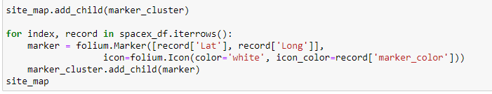
Marking the success/failed launches for each site on the map
The markers represent the successful and failed launches, in this map I only represent one of the location in the map as an example.
The green represent successful, while the red represent fail mark

Slide 39
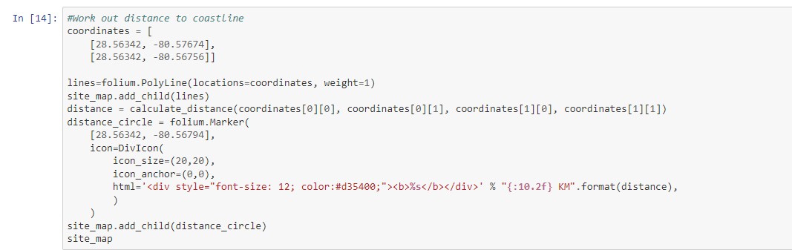
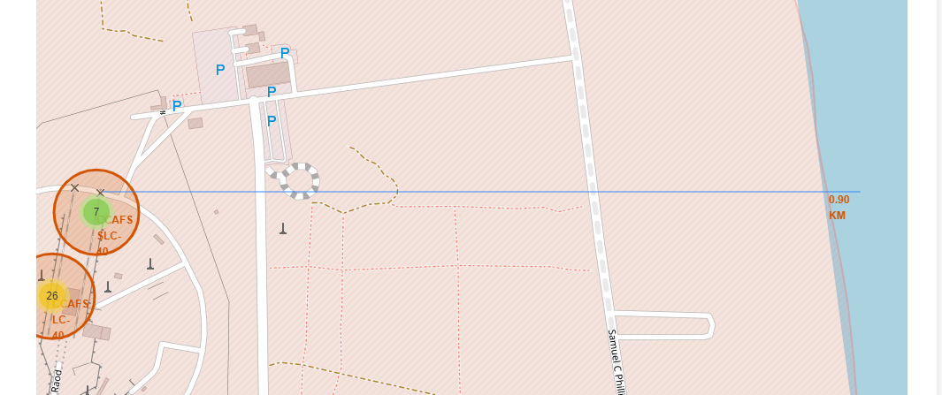
Calculating the distances between a launch site to its proximities
The line in the map represents the distance to the nearest shoreline
We will use some mathematics to figure out the length of the line.
In this example its only 9 KM

Slide 40


Slide 41
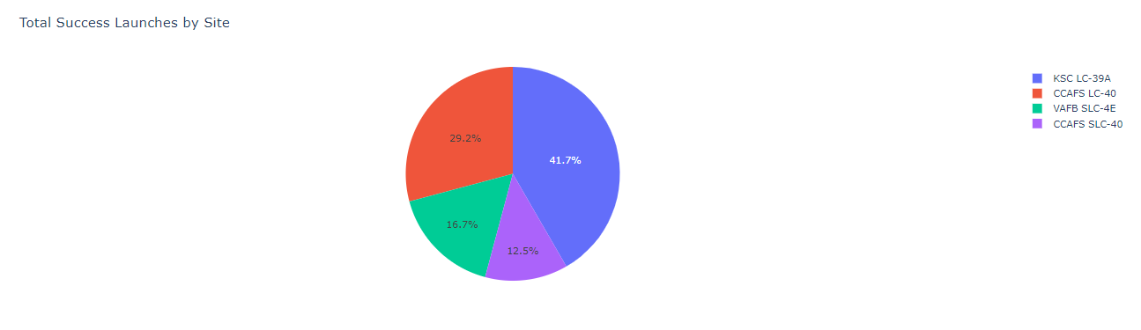
screenshot of launch success count for all sites, in a piechart
This pie chart represent the launch success count for each sites in the location.
This shows the KSC LC-39A gives the highest success count of 41.7%
And the CCAFS SLC-40 is the lowest success launch with 12.55.

Slide 42
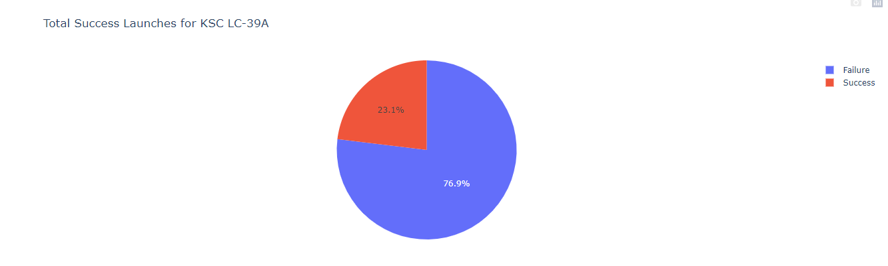
pie chart for the launch site with highest launch success ratio
Here is the relationship of the success and fail launch site of KSC LC 39A
The Ratio is 76.9/23.1 = 3.3 success ratio

Slide 43
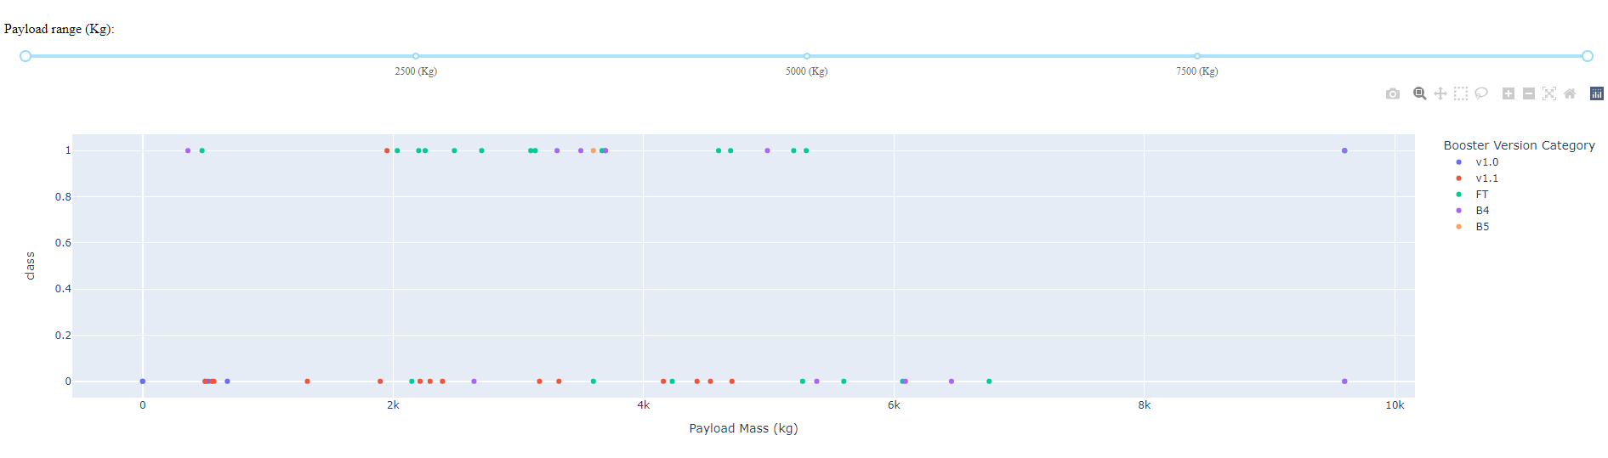
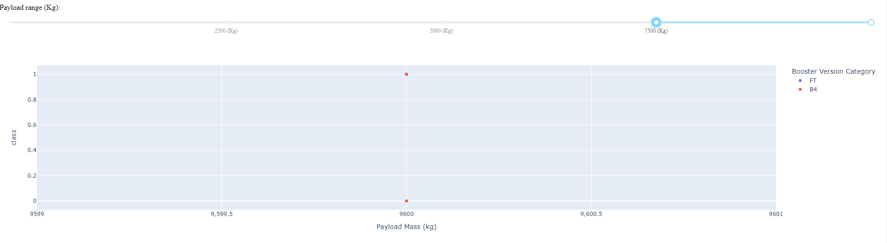
Payload vs. Launch Outcome scatter plot for all sites
The screenshots shows the relationship of the payload mass and the launch site class.
The slider represent different ranges of pay load mass values
The top one range is the full range of the data, a high payload mass, this shows that it has a strong relationship compared to the bottom screenshot which I put to a low range of payload mass. In the bottom screen shot, there is less relationship with the launch class.

Slide 44


Slide 45
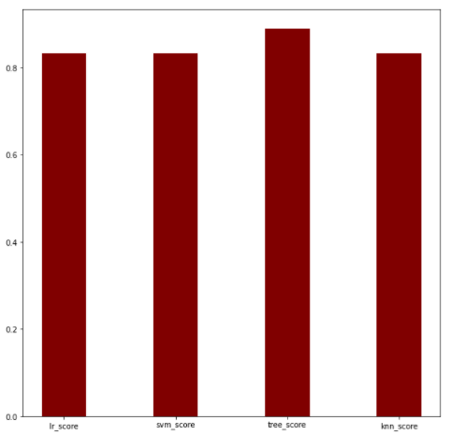
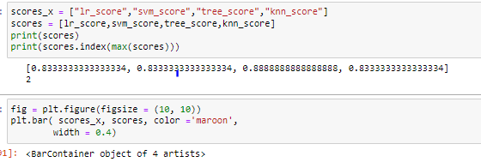
Classification Accuracy
After Analyzing through each module, the highest accuracy was the tree score module. With an accuracy of 0.89

Slide 46
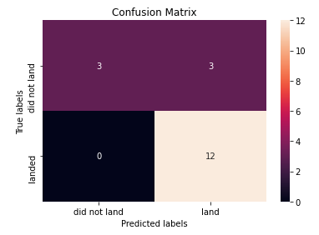
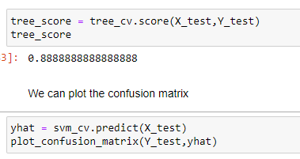
Confusion Matrix
Using the plot_confusion_matrix function I was able to create the confusion Matrix module.
This will evaluate the tree score module.

Slide 47
Conclusions
The best place for the launch site based on the Space X dataset, is at the location KSC LC 39A because of its environmental features based from its data.
After training and testing the data sheet I was able to build a machine learning module on four different types and the highest accuracy was the tree score module.
EDA Insights data tells us that the payload mass (Kg) is directly proportional to the successful launch rate (%).

Slide 48
Appendix
Information about the history of the falcon 9: https://en.wikipedia.org/wiki/List_of_Falcon_9_and_Falcon_Heavy_launches
Data collection: https://github.com/RaihanTeachesCodes/IBM_course_10-/blob/master/data%20collection.ipynb
Data wrangling: https://github.com/RaihanTeachesCodes/IBM_course_10-final-project/blob/master/data%20wrangling.ipynb
Data visualization: https://github.com/RaihanTeachesCodes/IBM_course_10-final-project/blob/master/EDA%20with%20Data%20Visualization.ipynb
EDA SQL: https://github.com/RaihanTeachesCodes/IBM_course_10-final-project/blob/master/eda%20sql.ipynb
Data visualization with folium: https://github.com/RaihanTeachesCodes/IBM_course_10-final-project/blob/master/interactive%20visualization%20with%20folium.ipynb
Space dash APP: https://github.com/RaihanTeachesCodes/IBM_course_10-/blob/master/spacex_dash_app.py
Machine Learning modules: https://github.com/RaihanTeachesCodes/IBM_course_10-/blob/master/Machine%20Learning%20Prediction.ipynb
My repositories: https://github.com/RaihanTeachesCodes/IBM_course_10-final-project

Slide 49


